Slide 1

Moody Predictive Analysis
Upsham Naik

Slide 2
The problem
Given the data for grades given by Professor Moody, we want to predict future grades based on the other variables provided
A | B | C | D

Slide 3

The First Step
In order to get an accurate prediction, we must first visualize the data we are working with to look for trends

Slide 4
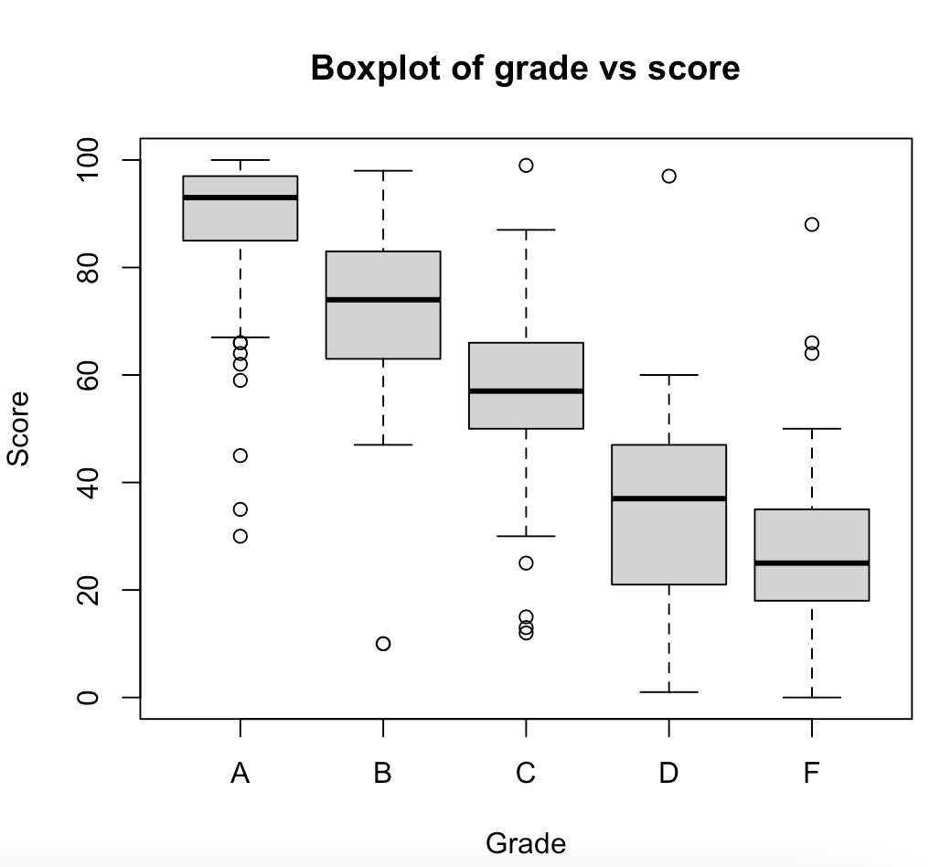
Grade Score Correlation
We first look at the correlation between Grades and Scores from the boxplot. For the most part, it is fairly uniform, however there seems to be an overlap between ‘D’ and ‘F’ that we will keep in mind

Slide 5
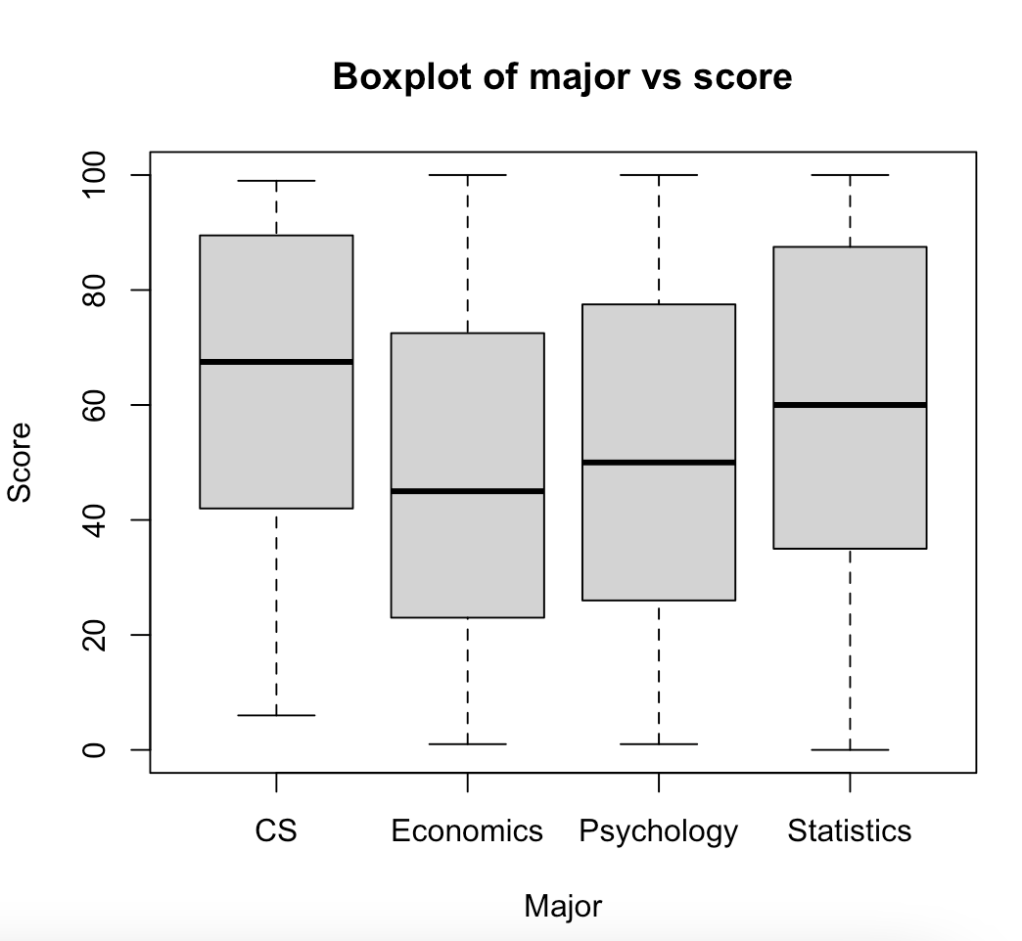
Major Score Correlation
Looking at the boxplot for major vs score, it seems students in CS generally scored higher and students in Economics generally scored lower. However, it is important to note that this does not mean CS students had higher grades than Econ students

Slide 6
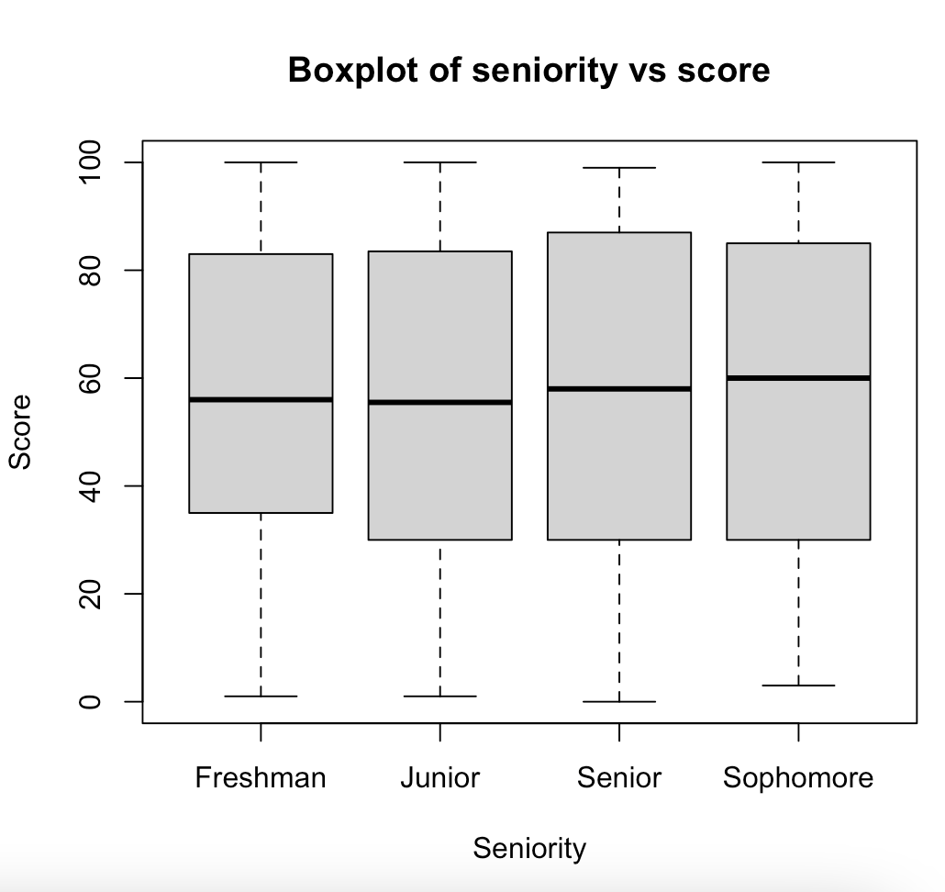
Seniority Score Correlation
This boxplot is pretty uniform and won’t tell us much without additional information

Slide 7

Further Analysis

Slide 8
We found some general trends, but we want a very accurate prediction. In order to do so, we will start to group the dataframe using bins

Slide 9
How it works
Step 3
Step 2
Step 1
We sort each Score value into its corresponding bin and finally sum each bin
We group the dataframe by each column and add the bin column
We split 100 into 10 bins of size 10, for e.g. (0, 10] is the first bin

Slide 10
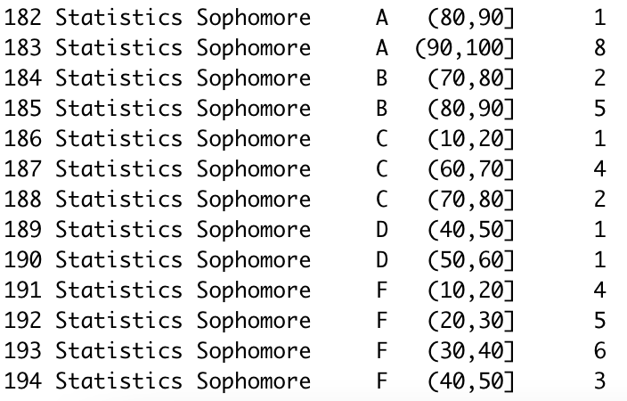
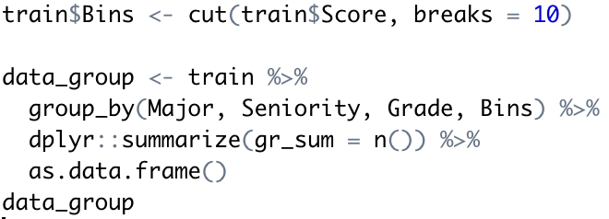
How it works
Code for creating bins:
Sample result of code:

Slide 11
The sample result of the last slides code can show us all of the information about Sophomore Statistics students. For e.g. we see the majority of students who received an A fell into the 90-100 Score range. As such, we would make a decision as such:

Slide 12
Decisions
Visual Analysis
Picking Score Range
Finalize Decision
By visually inspecting each combination of Seniority and Major, we eventually make a decision for a range of scores that corresponds best with each combination. Although tedious, it is the best way to make the most accurate prediction without the use of prebuilt ML models

Slide 13
R Code:
https://drive.google.com/file/d/14ljS57DuYB1qxmAXEb_F3uuB7OycgsHH/view?usp=sharing

